Slide 1

Hardwired Control Design and Analysis
Computer Organization and Architecture | Hardwired and Microprogrammed Control
Computer Organization and Architecture | Hardwired and Microprogrammed Control | Bachelor of Engineering
DISCOVER · LEARN · EMPOWER
Notes:
Welcome everyone to today's lecture on Hardwired Control. We are diving deep into the fundamental mechanisms that drive our processors. This topic is critical for understanding how instructions are executed at the hardware level. Let us begin by exploring the core concepts of this design approach.

Slide 2
Course Outcomes
SLIDE 2 / 10
Course Outcome
CO | BT LEVEL | DESCRIPTION
CO1 | BT3 | Apply number systems and digital logic to design basic digital circuits
CO2 | BT4 | Analyze register organization and instruction set architecture
CO3 | BT3 | Implement computer arithmetic algorithms and floating-point operations
CO4 | BT5 | Analyze memory hierarchy and input-output organization
CO5 | BT6 | Evaluate control unit design and pipelining performance
Chandigarh University
2 / 10
Notes:
Today's session is directly aligned with Course Outcome 5. You will learn to evaluate how different control unit designs impact overall system performance. Specifically, we will analyze how hardwired logic affects pipelining efficiency. This evaluation skill is essential for advanced computer architecture design.

Slide 3
Learning Objectives
SLIDE 3 / 10
Learning Outcomes
1
Analyze the fundamental structure of hardwired control units.
2
Evaluate the speed advantages of hardwired logic over microprogrammed methods.
3
Construct logic equations for specific instruction execution sequences.
4
Compare performance metrics between hardwired and microprogrammed designs.
5
Design optimized control signals for complex instruction sets.
Chandigarh University
3 / 10
Notes:
By the end of this lecture, you will be able to analyze the internal structure of hardwired controllers. We will evaluate why hardwired logic is faster than microprogrammed alternatives. You will also learn to construct the specific logic equations needed for instruction execution. Finally, we will compare these designs to understand their trade-offs.

Slide 4
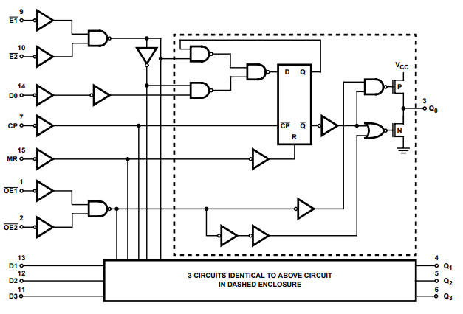
Lecture
SLIDE 4 / 10
Definition of Hardwired Control
1
Hardwired control uses fixed logic circuits to generate control signals.
2
The control logic is implemented using combinational logic gates and flip-flops.
3
Control signals are generated directly from the instruction register and status flags.
4
The design is optimized for speed by eliminating memory lookup delays.
5
Changes to the instruction set require physical redesign of the circuitry.
From Logic Gates to Registers: Exploring the 74HC173
Chandigarh University
4 / 10
Notes:
Hardwired control is essentially a fixed set of logic circuits that generate control signals. Unlike microprogramming, there is no control memory storing sequences of micro-instructions. The signals are generated directly from the instruction register and status flags. This direct generation makes the process extremely fast but rigid.

Slide 5
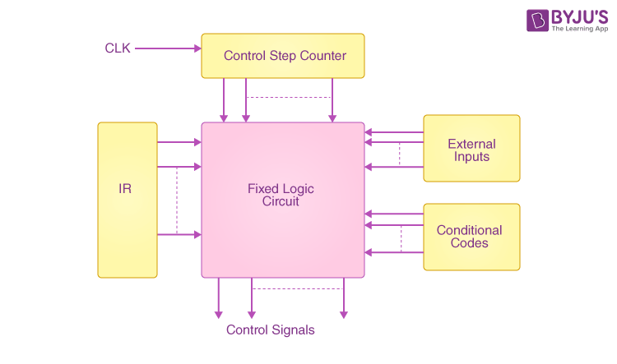
Lecture
SLIDE 5 / 10
Working Principle and Logic
1
The control unit decodes the opcode to activate specific logic paths.
2
State machine logic determines the sequence of control signal activation.
3
Each instruction triggers a unique combination of AND, OR, and NOT gates.
4
Timing signals synchronize the generation of control pulses with the clock.
5
The output is a set of parallel signals driving the datapath components.
Working of a Hardwired Control Unit - Generation of a Signal (source: cdn1.byjus.com)
Chandigarh University
5 / 10
Notes:
The working principle relies on decoding the opcode to activate specific logic paths. A state machine determines the exact sequence in which control signals are activated. Each instruction triggers a unique combination of logic gates to produce the required signals. Timing signals ensure that these pulses are synchronized perfectly with the system clock.

Slide 6
Lecture
SLIDE 6 / 10
Design Equations for Control Signals
GOVERNING EQUATION
Control signal C_i = f(Opcode, State, Status Flags) using Boolean algebra
EXAMPLE
ADD signal = (Opcode = ADD) AND (State = Execute).
• Minimization techniques like Karnaugh maps reduce the number of required gates.
• Complex instructions require multi-level logic to generate precise timing pulses.
• The total delay is the sum of propagation delays through the logic chain.
Chandigarh University
6 / 10
Notes:
The design relies on Boolean equations where each control signal is a function of the opcode and current state. For example, an ADD signal is generated when the opcode matches ADD and the state is Execute. We use minimization techniques like Karnaugh maps to reduce the number of gates needed. The total delay is simply the sum of propagation delays through the entire logic chain.

Slide 7
Numerical Example
SLIDE 7 / 10
Signal Generation
GOVERNING EQUATION
Total control signals required = 12 for ALU, Register, and Memory operations
1
Assume a 4-bit opcode and 3-state machine for a simple processor.
2
Logic depth for ADD instruction = 3 gate levels with 2ns delay each.
3
Total propagation delay = 3 levels × 2ns = 6ns for signal generation.
4
This delay must be less than the clock cycle time for correct operation.
Working of a Hardwired Control Unit - Generation of a Signal (source: cdn1.byjus.com)
Chandigarh University
7 / 10
Notes:
Let's look at a numerical example with a 4-bit opcode and a 3-state machine. We might need 12 control signals to handle ALU, register, and memory operations. If the logic depth for an ADD instruction is 3 gate levels with a 2ns delay each, the total delay is 6ns. This delay must be less than the clock cycle time to ensure correct operation.

Slide 8
Lecture
SLIDE 8 / 10
Advantages of Hardwired Control
1
Extremely high execution speed due to direct hardware implementation.
2
Lower latency for control signal generation compared to memory lookups.
3
Efficient for fixed instruction sets with frequent, simple operations.
4
No overhead from fetching micro-instructions from control memory.
5
Ideal for high-performance processors where speed is the primary constraint.
Chandigarh University
8 / 10
Notes:
The primary advantage is extremely high execution speed due to direct hardware implementation. There is lower latency because we avoid the overhead of fetching micro-instructions from memory. This approach is efficient for fixed instruction sets with frequent, simple operations. It is ideal for high-performance processors where speed is the primary constraint.

Slide 9
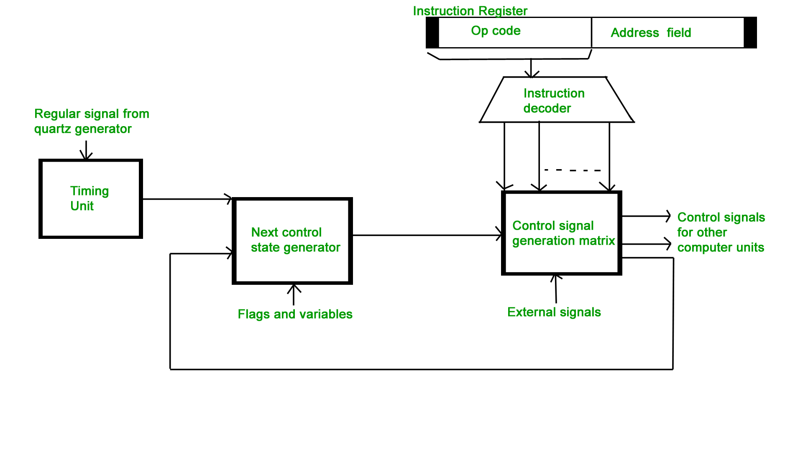
Lecture
SLIDE 9 / 10
Key Takeaways
1
Hardwired control uses fixed logic circuits for direct signal generation.
2
It offers superior speed but lacks flexibility for instruction set changes.
3
Design involves complex Boolean equations and state machine logic.
4
Propagation delay is the critical factor limiting maximum clock frequency.
5
Evaluation requires balancing speed against design complexity and cost.
Source: www.geeksforgeeks.org
Chandigarh University
9 / 10
Notes:
To summarize, hardwired control uses fixed logic circuits for direct signal generation. It offers superior speed but lacks flexibility for instruction set changes. The design involves complex Boolean equations and state machine logic. Propagation delay is the critical factor limiting maximum clock frequency. Evaluation requires balancing speed against design complexity and cost.

Slide 10
Lecture
SLIDE 10 / 10
References
COMPUTER ORGANIZATION AND DESIGN
The Hardware/Software Interface — David A. Patterson, John L. Hennessy
COMPUTER ARCHITECTURE
A Quantitative Approach — John L. Hennessy, David A. Patterson
• Computer Organization and Architecture — William Stallings
• Computer System Architecture — M. Morris Mano & Rajib Mall
• Computer Organization — Carl Hamacher, Zvonko Vranesic, Safwat Zaky
Chandigarh University
10 / 10
Notes:
These are the standard reference texts for this course. William Stallings and M. Morris Mano provide excellent foundational knowledge. Carl Hamacher and the works by Patterson and Hennessy offer deeper insights into quantitative analysis. Please refer to these books for further study on control unit design.

